Slide 1
Neighborhood enrichment grant Program fy 25/26
Neighborhood Improvement Program
Community Planning & Development
Notes:
Introductions first. Go over guidelines, create a FAQ based on training sessions, create sample application with training group.

Slide 2
overview
ABOUT
APPLICANT ELIGIBILITY
TIERED FUNDING
PROJECT ELIGIBILITY
PROJECT EXAMPLES
APPLICATION OVERVIEW
NEGP PROCESS
SPECIAL SCENARIOS
GRANT DELINQUINCY
TIMELINE
CONTACT INFO
APPLICATION WALKTHROUGH
Notes:
Essence: Intro
Marc: Everything up to Special Scenarios
Essence: Special Scenarios and the rest

Slide 3

About
The Neighborhood Enrichment Grant Program is a competitive grant available for neighborhood organizations to use on projects that improve quality of life for all residents within the neighborhood.

Slide 4

Who may apply?
Eligible applicants:
  Neighborhood Associations
  Homeowners’ Associations
  Property Owners Associations
  Other like neighborhood-based associations and related groups
Notes:
Including, but not limited to.
These organizations must be open to anyone that lives in the neighborhood (renters or owners). To be considered an official neighborhood organization, applicants must have: officers (required at minimum of a President, Secretary and Treasurer), established neighborhood boundaries, by laws, a tax identification number, IRS W-9 Form, and bank account dedicated to said organization.

Slide 5
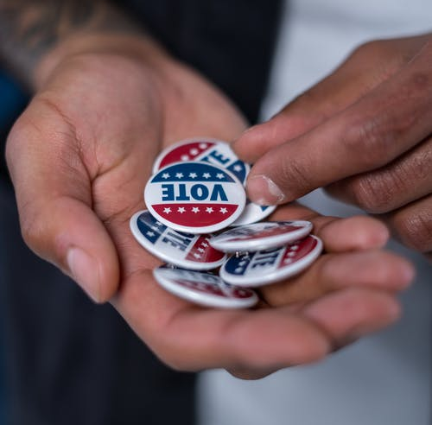
Who may not apply?
Ineligible applicants:
  Religious organizations
  Apartment management companies
  Businesses
  Umbrella organizations
  County wide organizations
  College/University Greek Organizations
  Colleges and Universities
  Political groups
  Public agencies
Notes:
Including, but not limited to.
Any group that is not a neighborhood-based organization and/or not located within Richland County is an ineligible applicant.

Slide 6
Tiered Funding
Tiers intended to support disadvantaged communities, determined by the presence of low-to-moderate income census block groups as defined by HUD.
Qualified block groups contain at least 50% of households that are low-to-moderate income
Tier 1
  $1,500 max
  Neighborhood boundaries do not include any low-to-moderate income areas
Tier 2
  $2,500 max
  A significant amount (at least 25%) of low-to-moderate income areas are within neighborhood boundaries
Notes:
25% or more of the neighborhood boundaries is made up of low – moderate income areas.

Slide 7
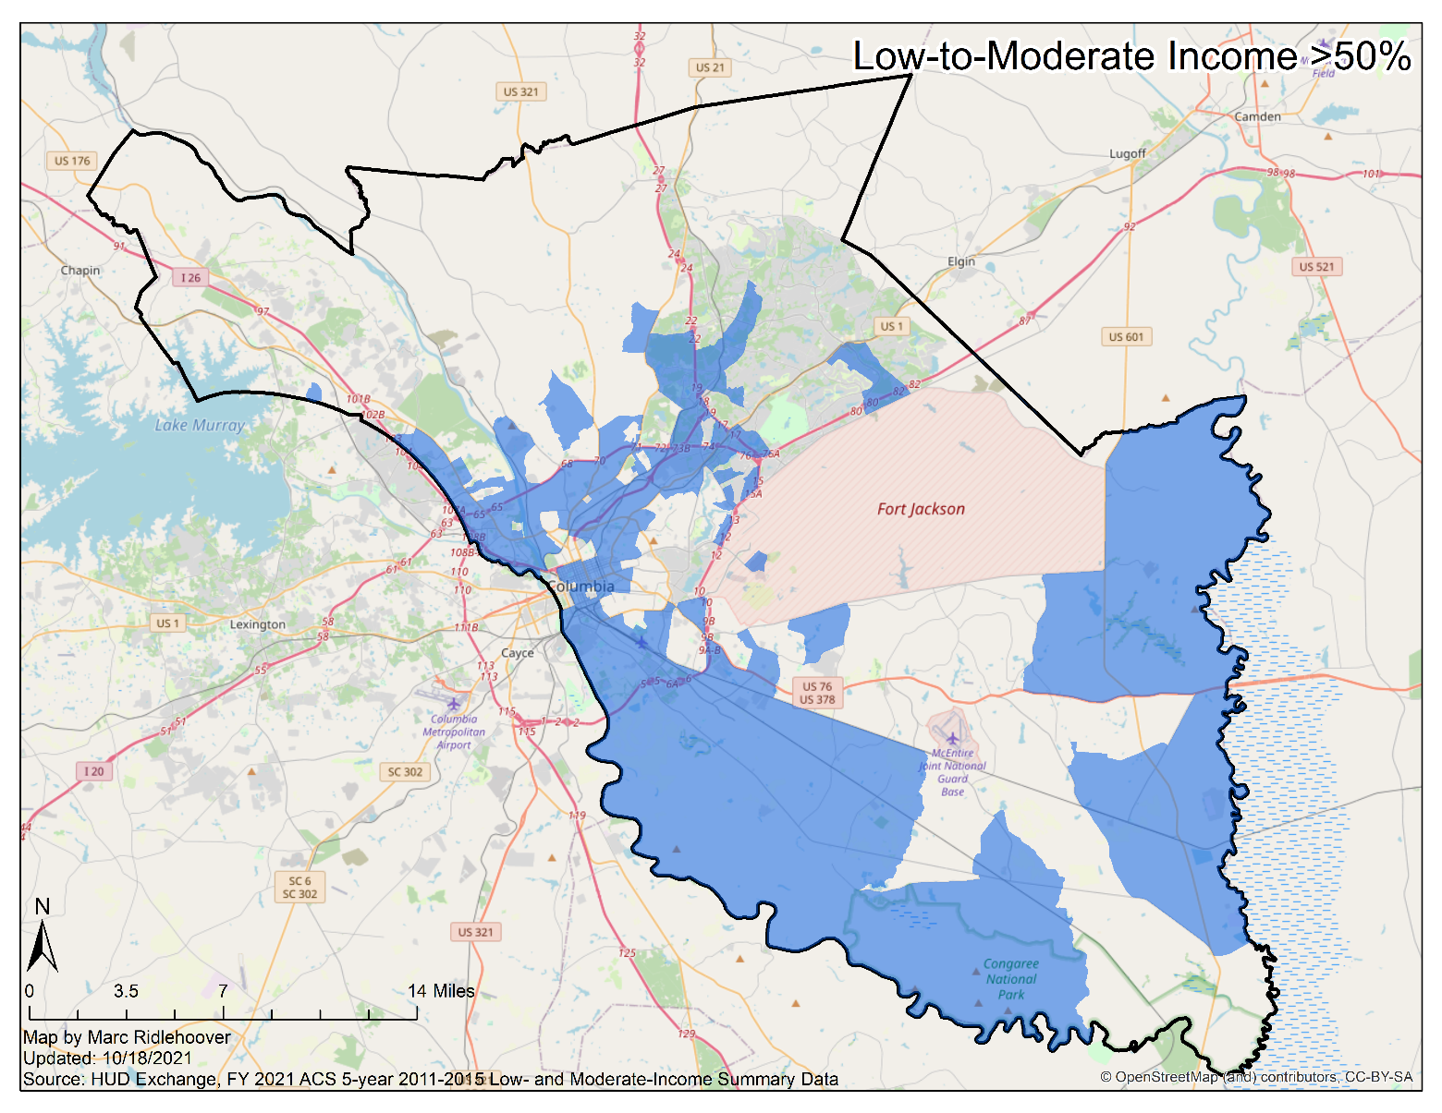
Are you eligible for Tier 2 Funding?
https://tinyurl.com/TIERMAPNEGP
Notes:
Tip: check neighborhood boundaries on NextDoor. Go to website and show them how

Slide 8
Eligible Projects
Neighborhood Beautification - Projects that improve the overall aesthetic of the neighborhood
  Clean ups
  Bush/flower planting
  Placemaking markers/monuments
Community Engagement - Projects that bring the community together
  Membership drive
  Newsletters & websites
  Back to school drive
Safety & Health - Projects that improve the safety and health of everyone in the neighborhood
  Surveillance cameras
  Emergency preparedness giveaway
  Traffic calming
Leisure - Projects that are just for fun
  National Night Out
  Block Party
  Little Free Library
Notes:
Not all inclusive. Recommend speaking with staff to discuss project ideas not listed in guidelines. Plants cannot be more than 4 feet tall at maturity.

Slide 9
Ineligible Projects
Major infrastructure improvements (i.e. sidewalk improvements)
Property purchases
Travel and travel expenses
Personal equipment
Alcohol, weapons or drugs
Plants more than 4’ tall
Awards/gift cards/coupons/prizes/raffles
Consulting, workshop, and speaker fees
Operating expenses (rent, utilities, insurance, etc.)
Fundraising or scholarships
Plants more than 4 feet tall at maturity
Equipment for businesses, schools, or government departments
Funding towards savings accounts
City of Columbia property
Funding towards schools, public agencies, and other non-profits
Expenses incurred prior to the grant award date
Personal computers, software, and personal computer supplies
Salaries/honorariums
Mailboxes
Reoccurring maintenance expenses
Home repairs for personal property

Slide 10

*Please include NIP logo on any signs, flyers, etc.

Slide 11
Application Overview
Required
Copy of most recent neighborhood organization’s bank statement
Official vendor quote/estimate for every proposed project expense. All quotes must include vendor letterhead. Quotes must be no more than 30 days old upon application submittal.
Copy of neighborhood organization’s by-laws
Completed latest version of IRS W-9 Form
Proof of permissions/permits (if applicable)
Optional
Map of neighborhood boundaries
Organization meeting minutes*
Notes:
*ORGANIZATION MEETING MINUTES SHOULD RELATE TO TIME SPENT DISCUSSING POTENTIOAL PROJECTS. This will help you in the scoring phase, which we will discuss shortly.

Slide 12
NEGP Process: Application Phase
Review Grant Guidelines
Check if your organization is eligible
Check if you are eligible for Tier 1 or 2
Decide on projects
Check if projects are eligible
Determine project dates
Determine project budget
Acquire any necessary permissions/permits
Fill out application form
Double-check application for accuracy
Keep a copy of your application for reference
Submit application
Wait for response from NIP
Notes:
+ NIP will not review until February 2023; call or email for any questions+ If NIP does not respond, we did not receive your application.
- Project dates must July 1st until June 30th.

Slide 13
If submitting application by email, please use the subject line:
"NEGP Application"

Slide 14
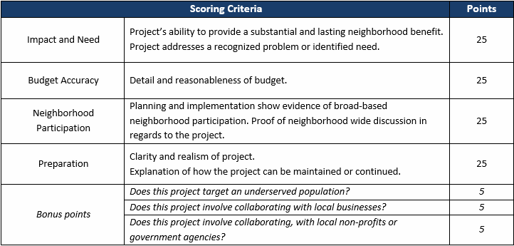
Project Scoring
Under our county guidelines, any single item costing $1,500 or more requires having 3 quotes submitted to compare pricing. Additionally, if you are purchasing multiple units of the same item that together total $1,500 or more, 3 quotes are also required.
Projects are evaluated by County staff (NOT NIP) on a 100-point scale
Projects must achieve a score of at least 70 to be considered for approval
Notes:
Make sure to involve the neighborhood residents and make sure the projects cater to the neighborhood and its residents.
Non-profits and gov. agencies may include but are not limited to: United Way
• Richland Library
• Voter Registration
• Healthy food organizations
• Palmetto Pride
• Personal budgeting organizations
• Job placement
• Home rehab & repair

Slide 15

NEGP Process: Award phase
Quick Application Check
Send A Confirmation Email When We Receive An Application
Review Process By Staff And County Council
Receive Your Award Packet Or Denial Letter
Sign And Submit Grant Agreement & Check Request Form
Pick Up Check

Slide 16
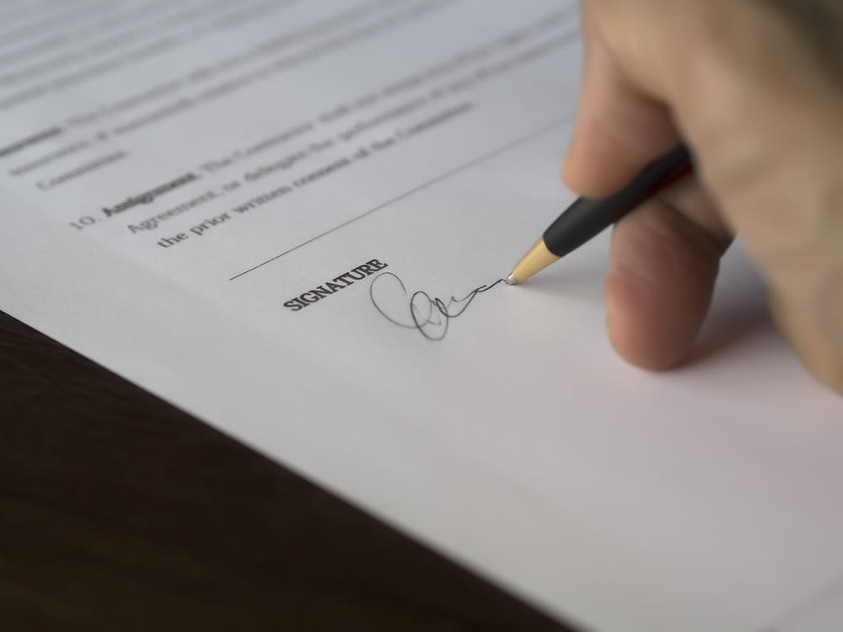
NEGP Process: Closeout
Implement your project(s)
Spend grant funds on eligible expenses
Prepare and submit Grant Closeout Report
  Expenditure Form
  Receipts
  Project proof (i.e. pictures, flyers, sign in sheets, etc.)
  Post-implementation Review (optional)
Notes:
Return any unspent funds by check. Must submit closeout to be eligible for grant in future.

Slide 17
Special scenarios
Grantee is awarded but did not request the check
  Grantee must submit a Termination of Grant letter
Grantee is awarded and did not cash the check
  Grantee must submit a Termination of Grant letter and return the check to NIP Staff.
Grantee is awarded and did cash the check, but did not spend funds
  Grantee must submit a Termination of Grant letter and return all awarded grant funds to NIP Staff via check. Check must be made to Richland County Finance Department.
Grantee is awarded, cashed the check, and spent partial award funds
  Grantee must submit a Termination of Grant letter and return remaining awarded grant funds to NIP Staff via check. Check must be made to Richland County Finance Department. Grant closeout Report is still required and must be submitted.
Notes:
All this MUST BE DONE ASAP AND WITHIN THE FISCAL YEAR. If they find themselves in any of these scenarios, and they don’t flow though, they will be blacklisted

Slide 18
Grant Delinquency !
If the Grantee has used NEGP funds on ineligible expenses, they must refund the amount spent on said expenses to Richland County Finance via check.
If the Grantee has broken rules as outlined in the NEGP Guidelines, the grantee’s organization will be unable to apply for funding in the future. Certain situations can allow the organization to receive funding again.

Slide 19
Timeline
Grant opening announcement: November, 2024
Application submittal period: December 2nd, 2023 – February 2nd, 2024
Review Process: February 2nd – June 30th, 2025
Award/Denial Notice: July 15th, 2025
Request a check: July 1st – September 30th, 2025
Grant Closeout Report Deadline: June 30th, 2026
(if necessary) return unspent funds by: June 30th, 2026

Slide 20
REMINDER
If submitting physical documents in-person or by mail, please do NOT use staples.
This also applies to the close out report.

Slide 21
NIP Contact INFO
Email: NIP@richlandcountysc.gov
Phone: 803-576-2166
Fax: 803-576-2182
Neighborhood Improvement Program Staff
Essence Holmes, Neighborhood Planner
Christopher ‘Marc’ Ridlehoover, Neighborhood Planner
Cheryl Johnson, Neighborhood Coordinator

Slide 22
Application Walkthrough
Notes:
If they need more project forms, they can find them on the webpage

